Slide 2
Age of Acceleration: Driving Digital Transformation
Sources: Gartner, Forbes, Capterra
Notes:
We’re in an age of acceleration. You get:
Faster (and smaller) devices
Your information faster – Google search –albeit not always accurate <wink wink>
Your technology faster – Apple App Store
Moore’s law was published in 1965 and loosely says that the pace of innovation doubles every 2 years. And as consumers and providers of technology, we’re all living with and seeing this every day…for some of us born near 1965, it’s all we’ve ever known.
And as consumers and providers of technology in this age of acceleration, we continue to want and do more.
By 2020, there will be:
11.6 BILLION mobile-connected devices and
1.7MB of data will be created EVERY SECOND for EVERY PERSON and
mobile data traffic will exceed 49 EXABYTES per MONTH by 2021
Yet the networking technology that connects all these elements together has not had a revolutionary change in nearly 30 years and if trends are any indication, nearly half of IT Staffs will be generalists within the next 3 years.
Source:
http://mobilefuture.org/the-rise-of-mobile-11-6-billion-mobile-connected-devices-by-2020/
https://www.cisco.com/c/en/us/solutions/collateral/service-provider/visual-networking-index-vni/mobile-white-paper-c11-520862.html
https://blog.capterra.com/10-surprising-big-data-statistics/
http://www.gartner.com/technology/research/predicts/
https://www.forbes.com/sites/louiscolumbus/2017/10/03/gartners-top-10-predictions-for-it-in-2018-and-beyond/#55a4cf9645bb

Slide 3
Applications
Soluções completas de Redes Físicas e Sem Fio, unificadas e gerenciadas a partir de um único painel, com a segurança da arquitetura Fabric.
DIGITAL
TRANSFORMATION
Support
Services

Slide 4
Why the Edge matters
IoT
Explosion
Pervasive Wi-Fi
Increased Network Attacks
Burdensome Maintenance
Expectations
Increase
75%
Connected to
WLAN
67%
Enterprise IT Cloud Adoption by 2020
100%
AI support of IoT by 2019
100%
Growth rate of Cloud Services for Mobile IoT
50%
Growth Rate in Discovery, Provisioning and Authentication
25B
IoT Devices
33%
Bluetooth (BLE) Beacon Growth Rate
25+%
Enterprise
Attacks will be IoT

Slide 5
Value of Extreme Smart OmniEdge
Pervasive
Intelligence
Business
Adaptive
Intrinsically
Secure
AI/ML
Extensive APIs
Actionable Analytics
Consistent experience
Hybrid-cloud flexibility
Investment protection
User security
Device security
Application security
5

Slide 6
Extreme Networks
Soluções de Rede Impulsionadas por Software, desde a Borda até a Nuvem
História da Inovação
Fundada em 1996
Mais de 20 anos, pioneira em networking
Primeiro Gig-E / 10 Gig-E Switch da indústria
Extenso portfólio de patentes
Soluções de Rede Enterprise e Cloud
# 1 em Serviço e Suporte
Força Global
Receita: US$ 1 bilhão
3.000+ funcionários
NASDAQ: EXTR
HQ em San Jose CA
Negócios em mais de 80 países
Mais de 30.000 clientes
Mais de 6.000 parceiros de tecnologia
Notes:
Gaining the trust of these customers didn’t happen overnight. It’s been achieved through years of great vision, great service and great technologies purpose-built to meet our customers’ needs.
Today, our vision is to be the recognized leader in software driven networking solutions.
However, this hasn’t always been the case
We have a heritage of quality and a pioneer in Ethernet networking
- We have been in business for over 20 years, delivering the 1st Gig Ethernet switch and then the 1st 10 Gig Ethernet switch
However, we were a box company
Over the last few years, we have transformed to an end-to-end enterprise networking company
And more and more, we are leading with software and services and delivering solutions because we recognize the best way to help you meet challenges in this age of acceleration is through software-driven networking. Software-based network applications can be updated more frequently, are easier to use, and provide platforms for automation…all important characteristics for greater operational agility and efficiency.
And, it’s working. We’re now a $1.2b company with over 3k employees, 4000 partners going business in over 80 countries with over 10,000 customers.
Summarize:
Agile, Adaptive, Secure
#1 Ranked Service & Support
Nimble, Right-Sized Company
We have solutions for ANY enterprise opportunity
Deliver and support vertical outcomes
Our differentiation:
Culture…accessible, agile, accountable and Action-oriented [Denise to reconcile with above
Open Architecture
End-to-end fabric
Software-driven solutions
100% insourced, Post-Sale Support
[TRANSITION:]
This is a BIG deal

Slide 7
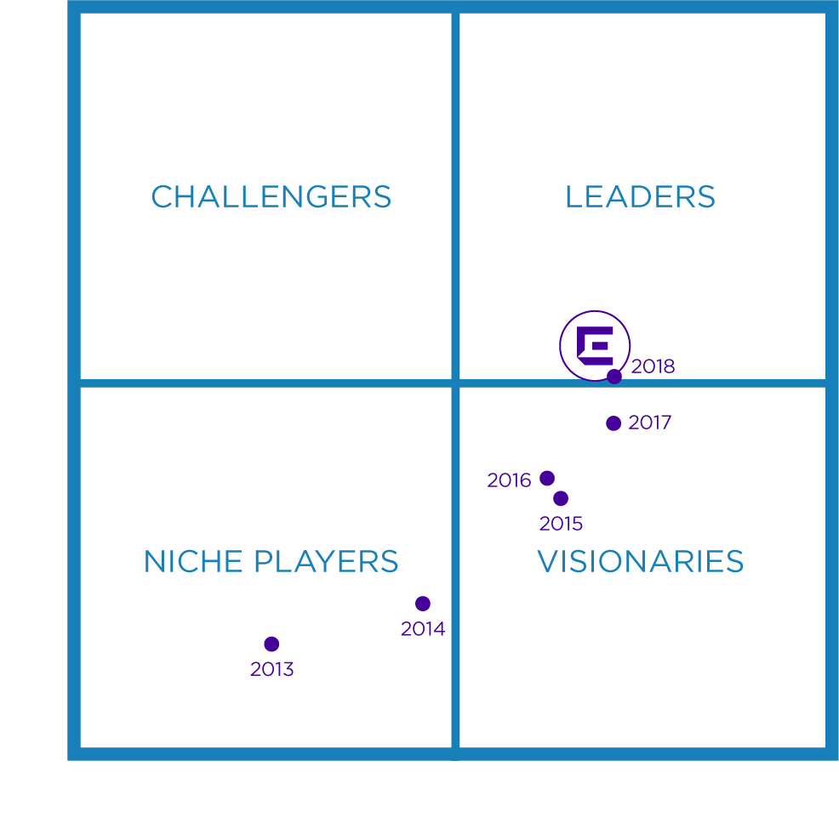
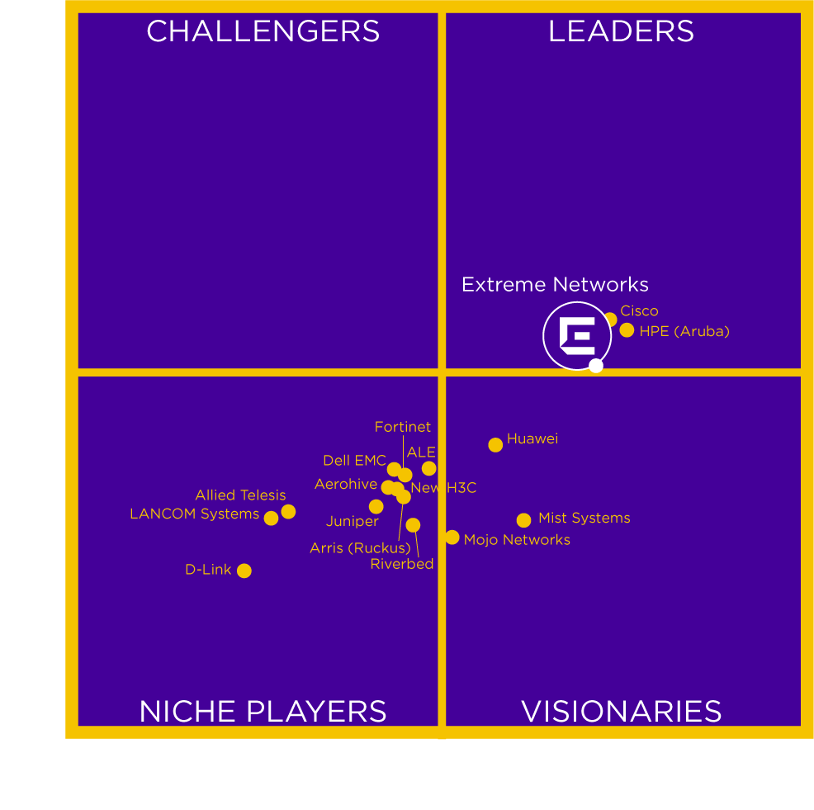
Validados por Analistas da Indústria
2018 LAN/WLAN Magic Quadrant
Notes:
Gartner also ranks us as a Leader in the 2018 LAN/WAN magic quadrant.
This graphic was published by Gartner, Inc. as part of a larger research document and should be evaluated in the context of the entire document. The Gartner document is available upon request from https://extr.co/2KOk7BI
Gartner does not endorse any vendor, product or service depicted in its research publications, and does not advise technology users to select only those vendors with the highest ratings or other designation. Gartner research publications consist of the opinions of Gartner's research organization and should not be construed as statements of fact. Gartner disclaims all warranties, expressed or implied, with respect to this research, including any warranties of merchantability or fitness for a particular purpose.

Slide 8
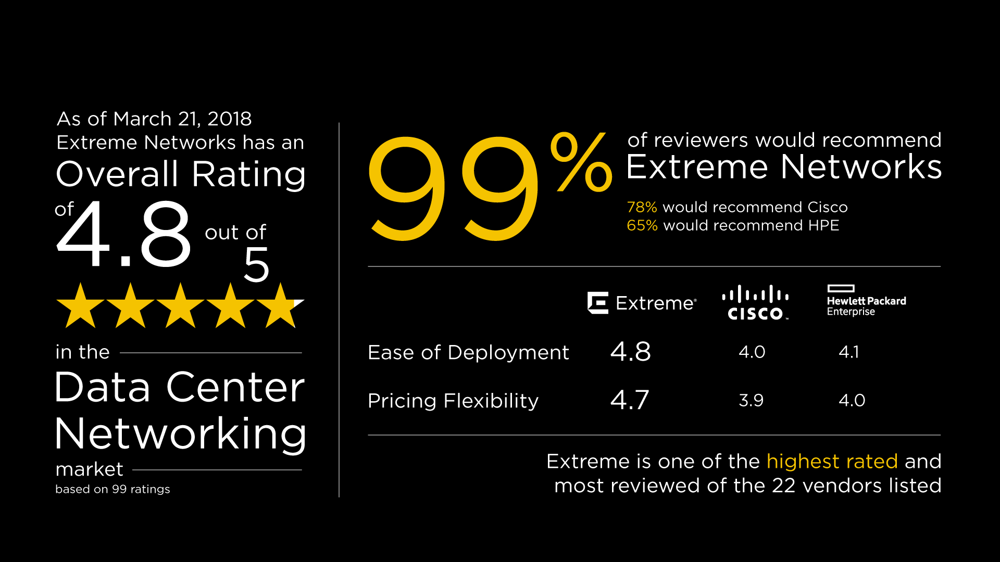
Industry Verified
#1 Ranked Service/Support – Gartner
See the reviews at: https://www.gartner.com/reviews/market/data-center-networking
Notes:
Gartner ranks Extreme Networks #1 in service and support.
With 40% of IT becoming generalists by 2021, service and support will be critical.
Extreme is the only networking vendor with 100% in-sourced support enabling us to achieve a 94% first-person resolution rating.
That’s probably why Gartner ranks Extreme service and support #1 with a 4.8 out of 5 stars.
Ninety-nine percent of all reviewers would recommend Extreme Networks…
…placing us as one of the HIGHEST RATED and MOST REVIEWED of the 22 vendors listed.
In 3 critical decision-making categories, we beat Cisco and HPE handily.
We’re 21 percentage points ahead of Cisco and 34 points ahead of HPE when it comes to reviewers recommendations..
And we beat them both in terms of Ease of Deployment and Pricing Flexibility

Slide 9
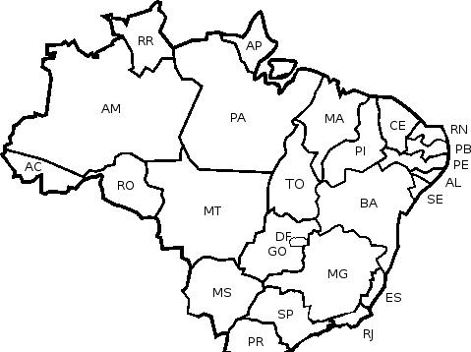
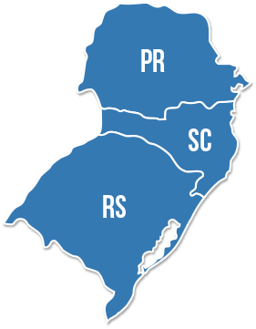
Extreme no Sul – Mercado Educacional

Slide 10
Obrigado!

Slide 11
Extreme no Sul – Mercado Educacional

Slide 12
Soluções Inteligentes
TechDEC Informática S/A

Slide 13
Oferecer soluções na área da informática para o mercado corporativo, governamental, educacional, com tecnologia de ponta, buscando a completa satisfação do CLIENTE, pois ele é a nossa razão de existir
Nossa Missão

Slide 14
Nossos Parceiros

Slide 15
Alguns de Nossos Clientes

Slide 16
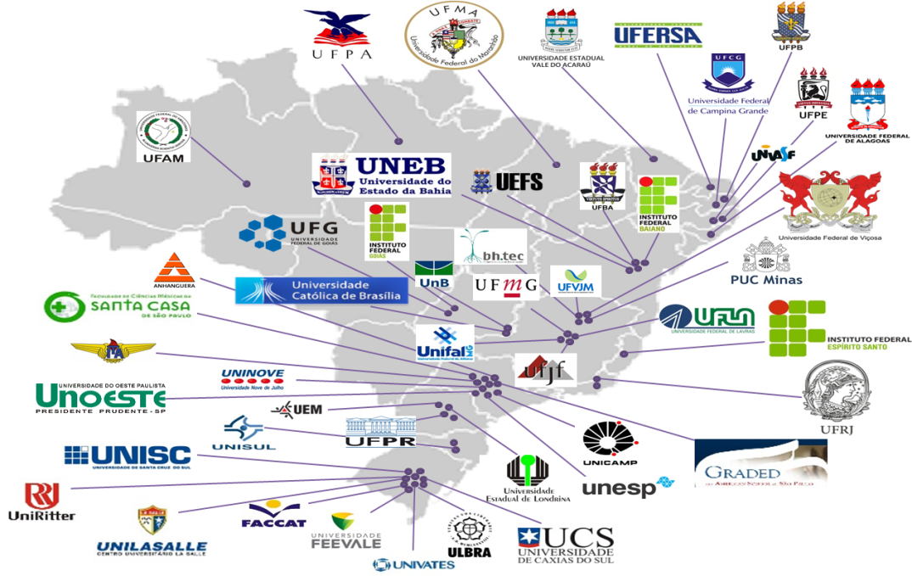
Extreme Conectando Estudantes pelo Brasil

Slide 17
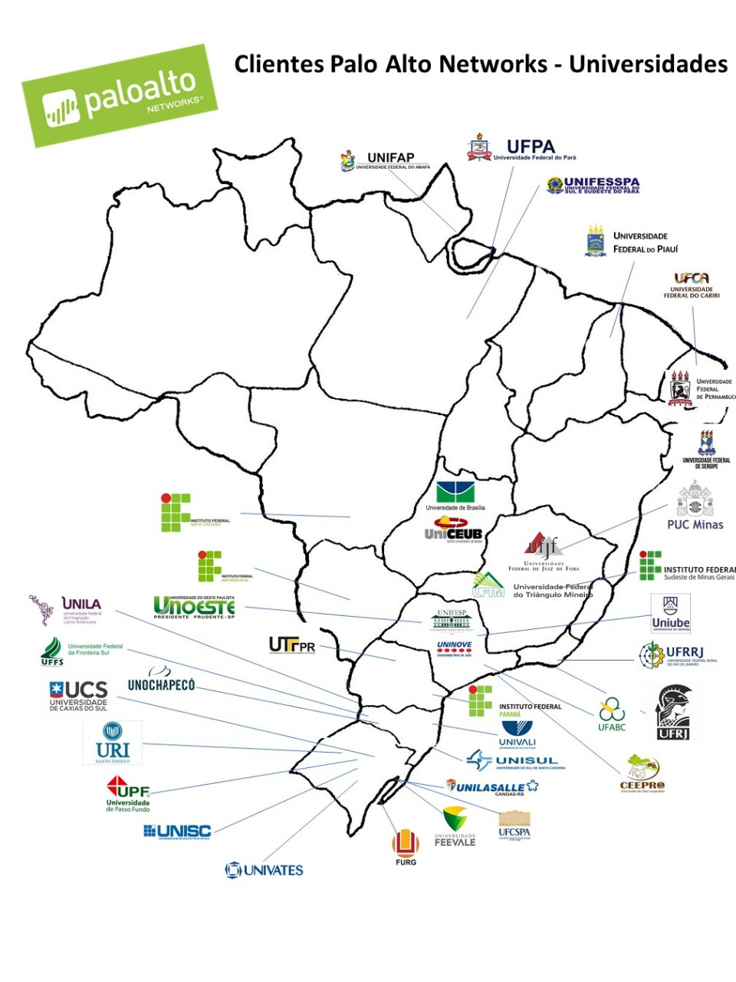
Solução Palo Alto Educação

Slide 18
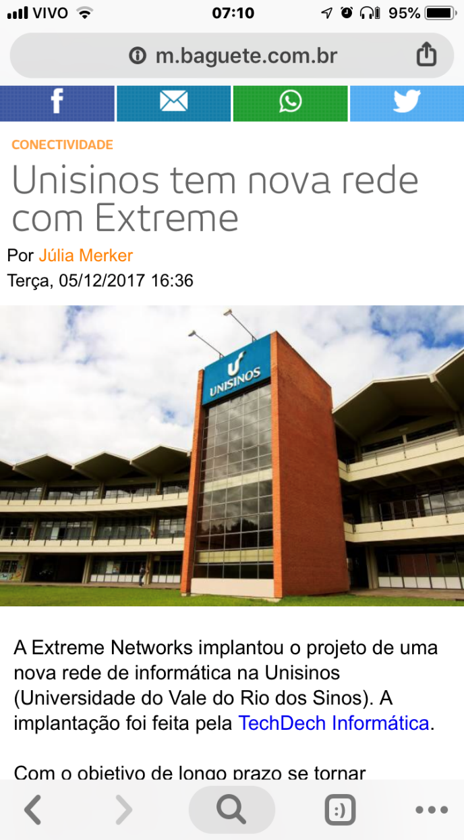
Caso de Sucesso – Unisinos

Slide 19
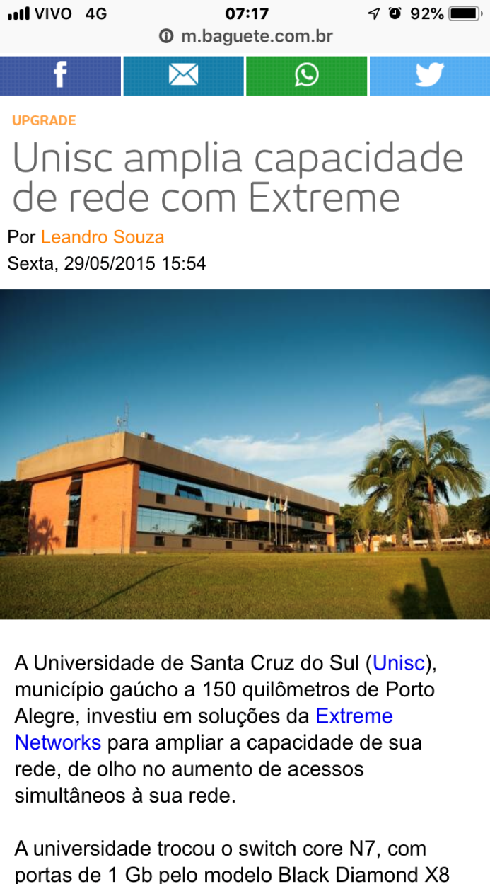
Caso de Sucesso – UNISC

Slide 20
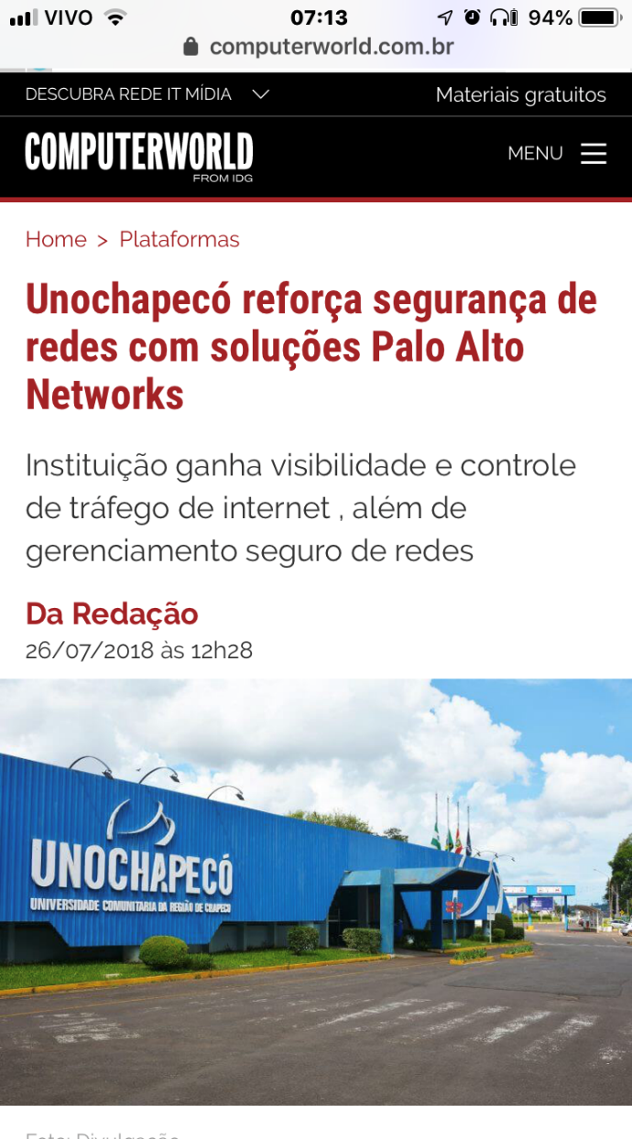
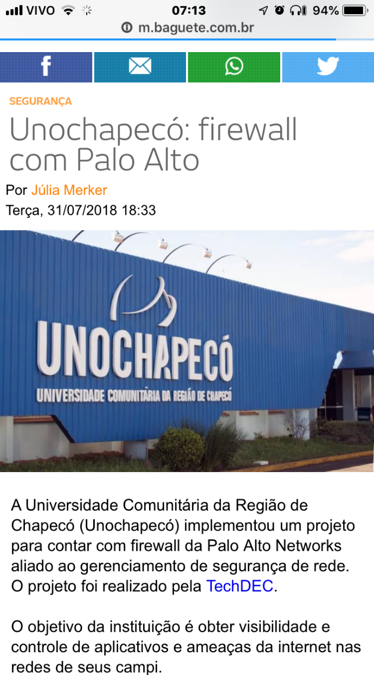
Caso de Sucesso – Unochapecó

Slide 21
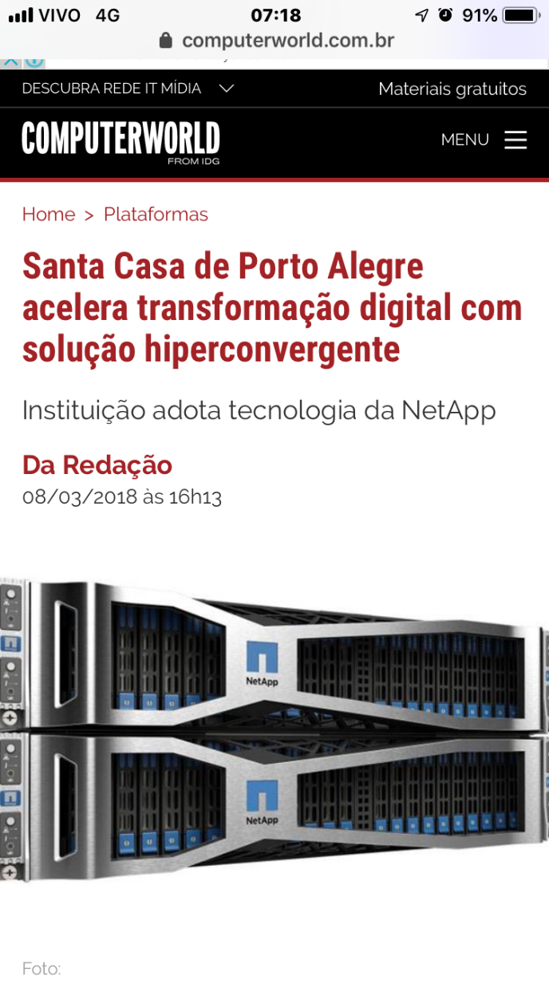
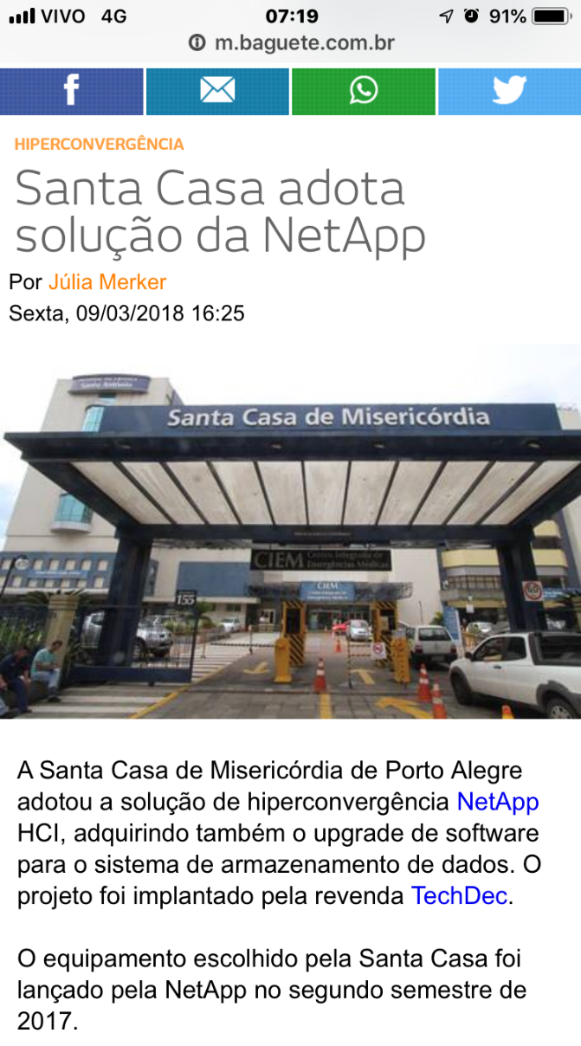
Caso de Sucesso – Santa Casa Porto Alegre

Slide 22
Caso de Sucesso – Pref. Caxias do Sul

Slide 23
Novas Necessidades

Slide 24
www.techdec.com.br alessandro.medeiros@techdec.com.br 51 999983-4641 51 3381-7600
OBRIGADO !

